Slide 1
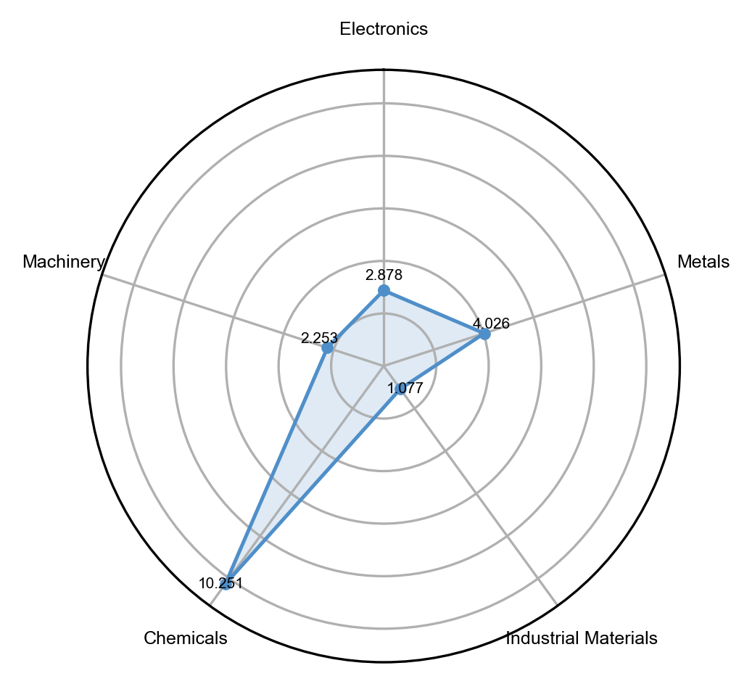
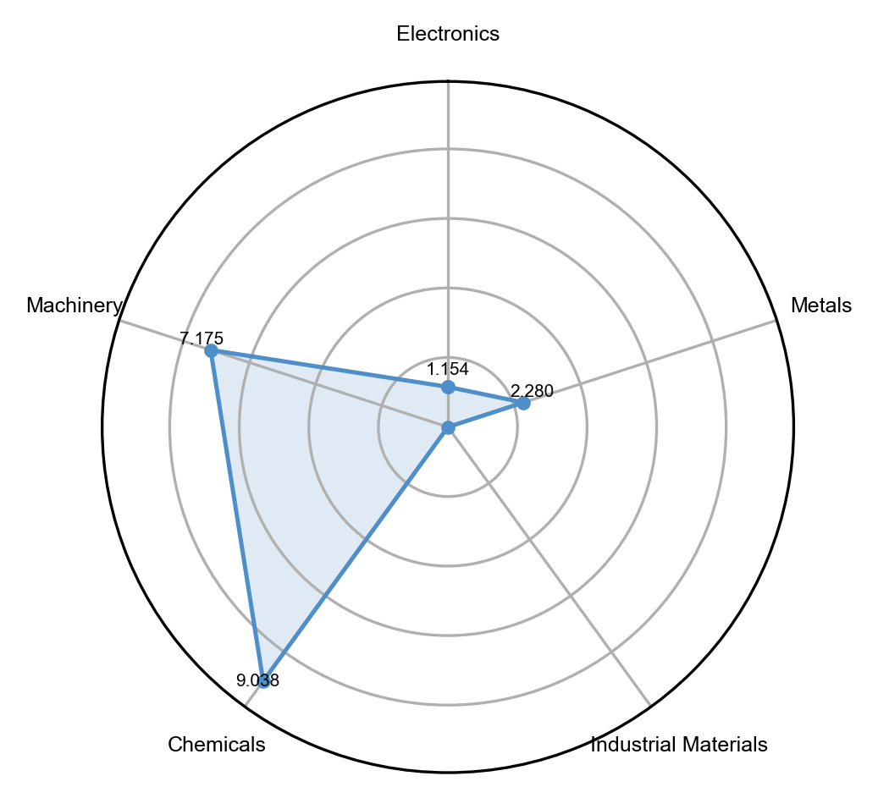
HS Code | Description | Category | Mean z-score
830249 | Mountings, fittings and similar articles...of base metal | Metals | 0.715290588
392350 | Plastics; stoppers, lids, caps and other closures... | Chemicals | 0.659440095
851440 | Heating equipment; for the heat treatment by induction... | Electronics | 0.626772306
851430 | Furnaces and ovens... | Electronics | 0.623957749
730890 | Iron or steel structures and parts... | Metals | 0.604073196
940390 | Furniture; parts | Machinery | 0.602998191
732690 | Iron or steel; articles n.e.s. | Metals | 0.601553918
392069 | Plastics; plates, sheets, film, foil and strip, of polyesters... | Chemicals | 0.593027456
854389 | Electrical machines and apparatus... | Electronics | 0.578359649
700719 | Glass; safety glass, toughened (tempered)... | Industrial Materials | 0.566543511
HS Code | Description | Category | Mean z-score
846231 | Machine-tools; shearing...for working metal | Machinery | 0.69599058
391190 | Polysulphides and similar products of chemical synthesis | Chemicals | 0.67484357
382490 | Chemical products... | Chemicals | 0.66253734
903039 | Instruments and apparatus for measuring or checking voltage... | Machinery | 0.6561503
846221 | Machine-tools; bending, folding, straightening...for working metal | Machinery | 0.64197594
847990 | Machines and mechanical appliances... individual functions | Machinery | 0.64047919
761699 | Aluminium | Metals | 0.61952362
903190 | Instruments; parts...for measuring or checking devices... | Machinery | 0.61405946
282540 | Nickel oxides and hydroxides | Chemicals | 0.60581447
851580 | Welding machines and apparatus | Electronics | 0.60114896

